Slide 1

Drugstore in Santiago de Chile.

Slide 2

Introduction
Through this exercise we can see if there is a clear competitive advantage in the location of a pharmacy in that sector and how is the current distribution in the area.
And mainly answer:
What advice would you give to someone who wants to invest in a pharmacy in the area?

Slide 3


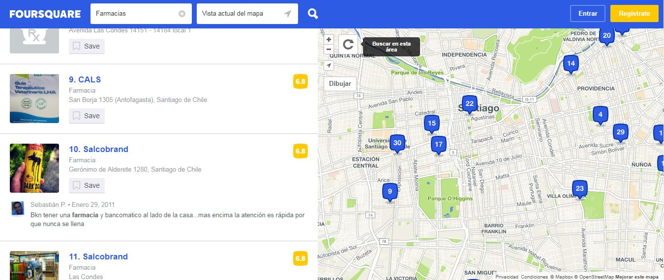
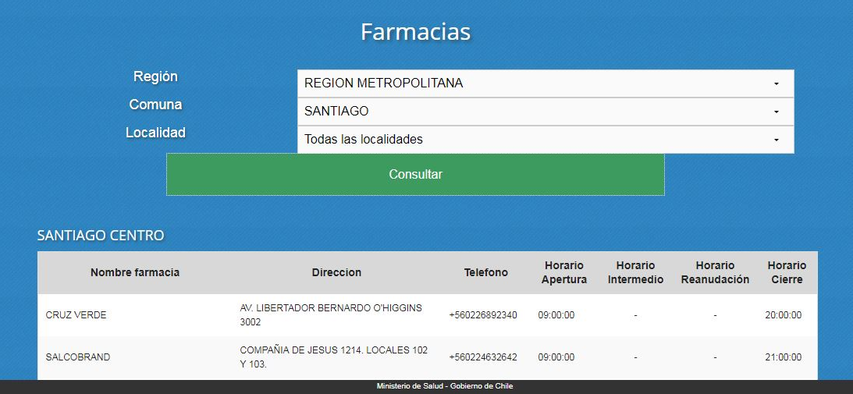
Main sources of information.

Slide 4
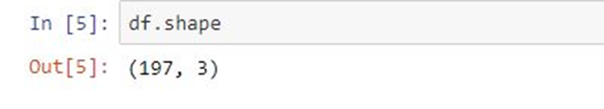
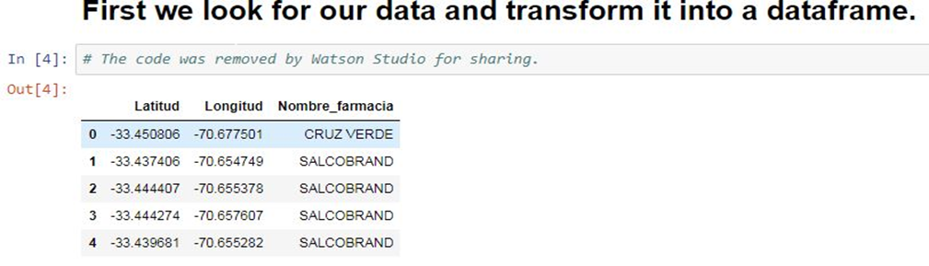
3.1 First stage
The data obtained was filtered and the records of points outside the area to be investigated were eliminated.
Subsequently, it was entered as a dataframe with 3 columns [Nombre_farmacia, Latitud, longitud], which are the basis of the models.

Slide 5
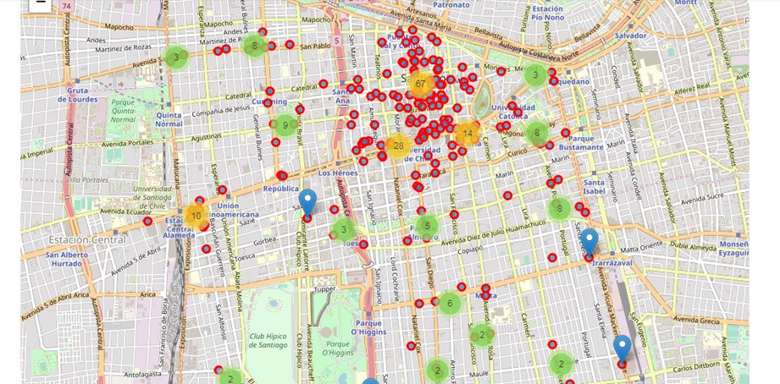
3.1 First stage
Distribution of drugstore in the area

Slide 6
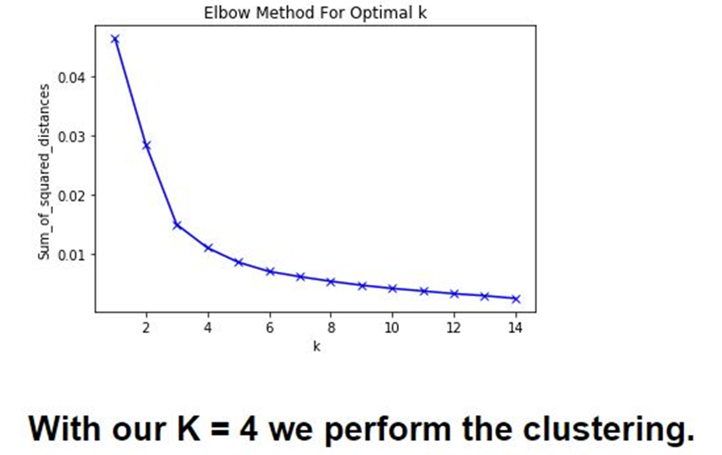
3.2 Second stage
To perform the clustering with a K with greater accuracy the step we see below was necessary.

Slide 7
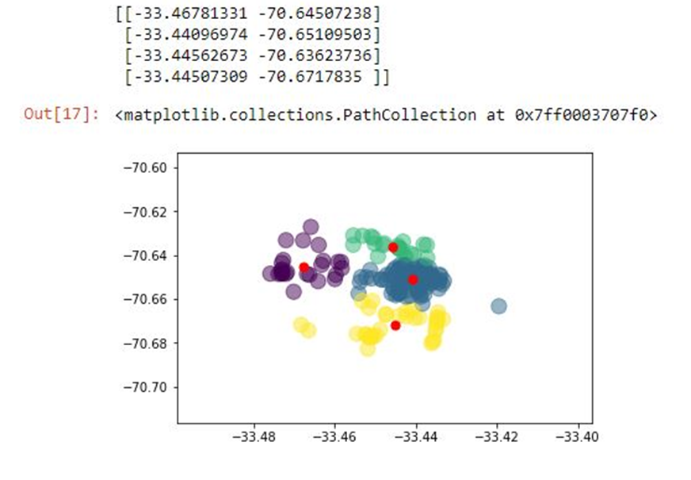
3.2 Second stage

Slide 8
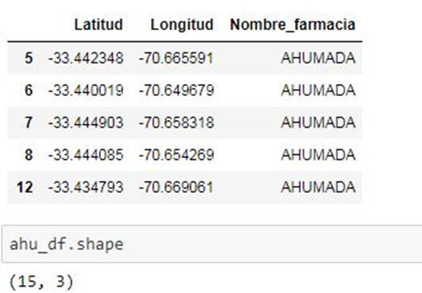
3.3 Third stage
Objective: Divide the database into 4 groups to obtain the total amount of each pharmacy of "Chain" and what is the location of these 4 groups in the plan of the commune.

Slide 9
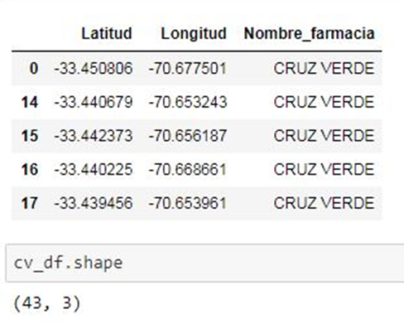
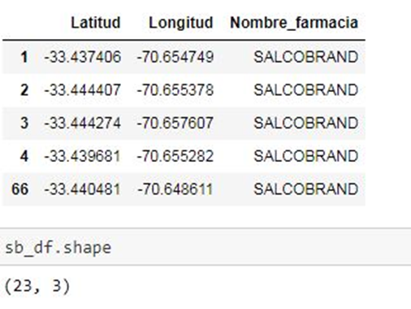
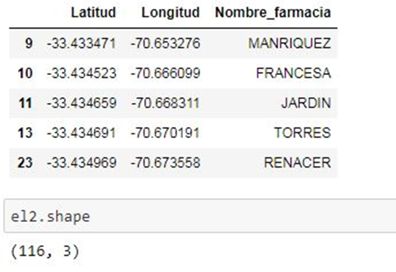
3.3 Third stage

Slide 10
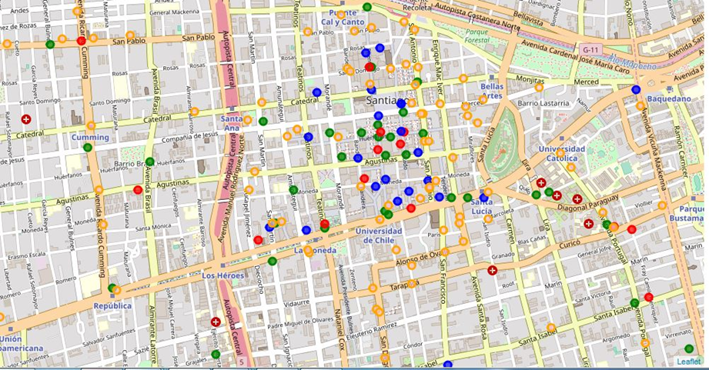
3.3 Third stage

Slide 11
4 Results
As we can see, there are approximately 197 pharmacies in the commune of Santiago, which has an area of 23.2 km2, of which 81 local belong to the so-called "Chain Pharmacies", the remaining reach 59% which is close to 57%. which shows that the proportion shown at the national level is maintained.
Another observation that we can make is that there is a very high concentration in an area smaller than approximately 30 blocks (about 300 m2), this high concentration is located in a neuralgic zone of the country, in which the "Plaza de Armas" is located, the Government Palace and countless government agencies and private companies.
This high concentration is composed mostly of the three largest companies, leaving the rest in peripheral areas.

Slide 12
5 Conclusion
We can see through this exercise that in the Chilean pharmaceutical market there is definitely an oligopoly of 3 large companies, and for its market strategy it is of vital importance the location of its premises, agglomerating almost 30% of the pharmacies of the commune in an area of approximately 1% of the area in question, most of which are located in the previously mentioned chains and the other companies are in peripheral areas.
One of the factors of this distribution may be the value of the land in case of purchase or lease, which would be excessively high serving as a barrier to entry for other possible competitors along with the excessive centralization that exists in the country-region-commune-area that discourages growth elsewhere
Another point to consider is the type of drugstore to be installed, since of the few independents that have been inside the "Principlal" zone as a possible competition, most of them are dedicated to other types of drugs, more oriented to alternative medicines. , topic which could be further investigated in another opportunity.
In conclusion, we would suggest someone who wants to invest in this type of business to invest in an establishment located in the "Main" zone and preferably sell drugs related to alternative medicines to avoid a direct commercial confrontation with companies that already dominate the market.

Slide 13
Other sources
https://www.odepa.gob.cl/wp-content/uploads/2018/03/Metropolitana.pdf
https://www.cooperativa.cl/noticias/pais/transportes/metro/el-metro-de-santiago-esta-transportando-a-2-6-millones-de-personas-en/2018-06-27/093857.html
https://nbviewer.jupyter.org/github/Rentm81/Coursera_Capstone/blob/master/semana9-5-code.ipynb
Thank you!!!

